Slide 1
Design and Analysis of Algorithms CS345
Lecture 3
Non-Dominated Points problem
Multiplication of two polynomials problem

Slide 2
Non-dominated Points

Slide 3


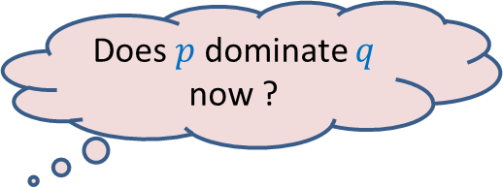


The Non Dominated Points
Given a set $P$ of $n$ points
Definition: point $p$ is said to dominate point $q$ if
x($p$) > x($q$)
and y($p$) > y($q$)
Does $p$dominate $q$ now ?
$$p$$
$$q$$
NO
$$q$$

Slide 4

The Non Dominated Points
Given a set $P$ of $n$ points
Definition: point $q∈P$ is said to be non-dominated point if
there is no point $p∈P$ such that
x($p$) > x($q$)
and y($p$) > y($q$)
$$p$$
$$q$$

Slide 5
The Non Dominated Points
How does the structure formed by all the non-dominated points look like ?

Slide 6
A Divide and Conquer algorithm

Slide 7

A Divide and conquer algorithm
$\frac{n}{2}$points
$\frac{n}{2}$points

Slide 8




A Divide and conquer algorithm
O($n$ $\log{ n}$)
O($n$ $\log{ h}$)
O($n h$)
$\frac{n}{2}$points
$\frac{n}{2}$points

Slide 9
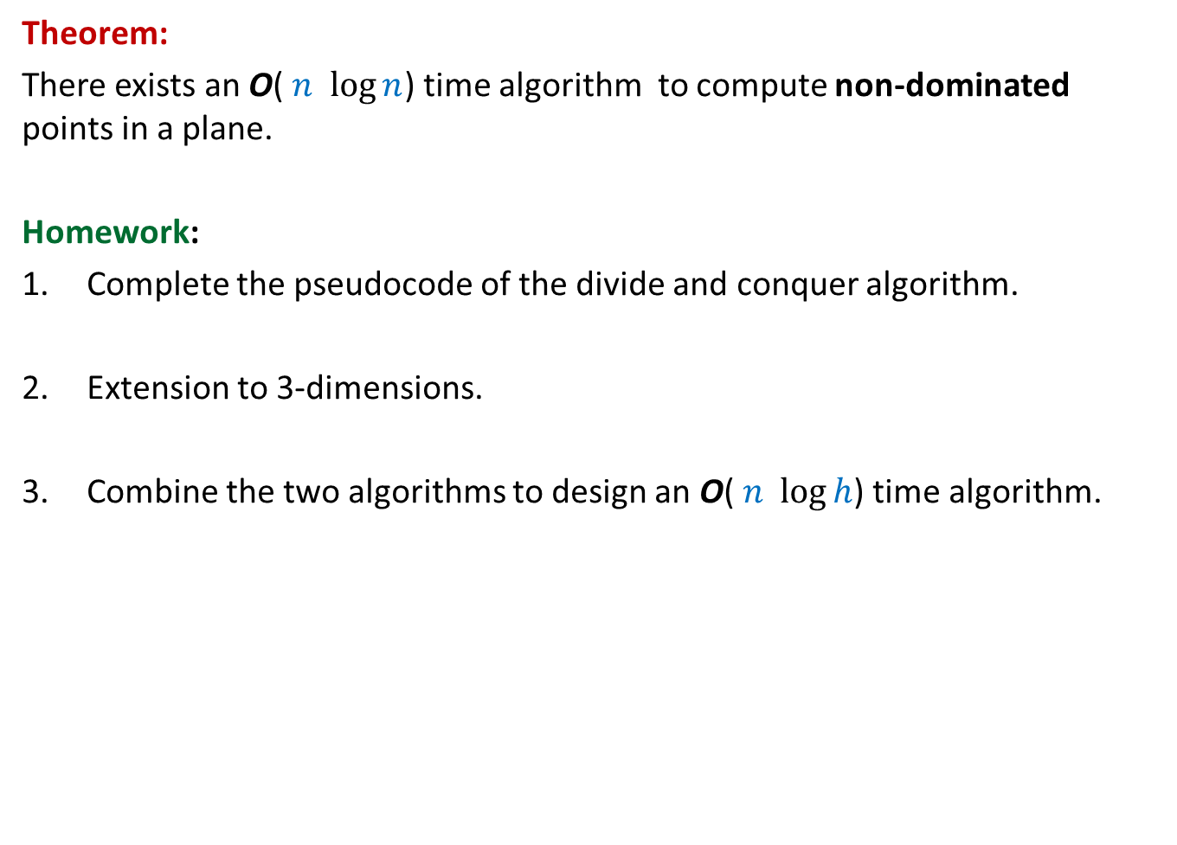
Theorem:
There exists an O( $n$ $\log{n}$) time algorithm to compute non-dominated points in a plane.
Homework:
Complete the pseudocode of the divide and conquer algorithm.
Extension to 3-dimensions.
Combine the two algorithms to design an O( $n$ $\log{h}$) time algorithm.

Slide 10
An algorithm for multiplying two polynomials

Slide 11

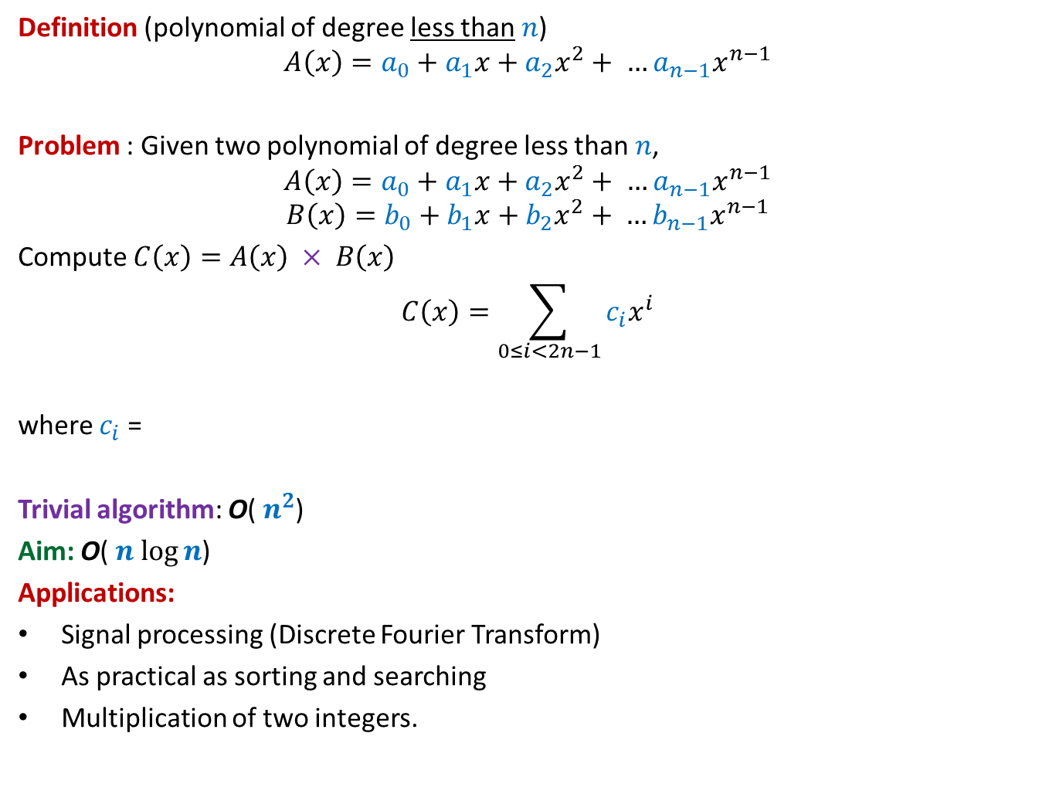

Multiplying two polynomials
Definition (polynomial of degree less than $n$)
$$A\left(x\right)=a_{0}+a_{1}x+a_{2}x^{2}+ …a_{n−1}x^{n−1}$$
Problem : Given two polynomial of degree less than $n$,
$$A\left(x\right)=a_{0}+a_{1}x+a_{2}x^{2}+ …a_{n−1}x^{n−1}$$
$$B\left(x\right)=b_{0}+b_{1}x+b_{2}x^{2}+ …b_{n−1}x^{n−1}$$
Compute $C\left(x\right)=A\left(x\right) × B\left(x\right)$
$$C\left(x\right)=\sum_{0≤i<2n−1}{c_{i}x^{i}}$$
where $c_{i}$ =
Trivial algorithm: O( $n^{2}$)
Aim: O( $n$ $\log{n}$)
Applications:
Signal processing (Discrete Fourier Transform)
As practical as sorting and searching
Multiplication of two integers.
$$a_{0}b_{i}+a_{1}b_{i−1}+a_{2}b_{i−2}+ …+a_{i−1}b_{1}+a_{i}b_{0}$$
O($i$) time

Slide 12

Representation of a polynomial ?
Coefficient representation:
$$A\left(x\right)=a_{0}+a_{1}x+a_{2}x^{2}+ …a_{n−1}x^{n−1}$$
$<a_{0}, a_{1},a_{2},…,a_{n−1}>$
Is there any alternate representation possible ?

Slide 13







Representation of a polynomial ?
Alternate representation of polynomial
“$A\left(x\right)=a_{0}+a_{1}x$”
{$(r_{0}, A\left(r_{0}\right)),(r_{1}, A\left(r_{1}\right))$}
for any distinct $r_{0}$ and $r_{1}$uniquely define $A\left(x\right)$.
Alternate representation of polynomial “$A\left(x\right)=a_{0}+a_{1}x+a_{2}x^{2}$”
{$(r_{0}, A\left(r_{0}\right)),(r_{1}, A\left(r_{1}\right))$, $(r_{2}, A\left(r_{2}\right))$}
for any distinct $r_{0}$,$r_{1}$, and $r_{2}$ uniquely define $A\left(x\right)$.
a line ☺
a parabola ☺
$$(r_{1}, A\left(r_{1}\right))$$
$$(r_{2}, A\left(r_{2}\right))$$
$$(r_{0}, A\left(r_{0}\right))$$
$$(r_{1}, A\left(r_{1}\right))$$
$$(r_{0}, A\left(r_{0}\right))$$
Generalization ?

Slide 14

Representation of a polynomial ?
Theorem:
Let {$(r_{0},t_{0}),(r_{1},t_{1})$, …, $(r_{m−1}, t_{m−1})$} be $m$ pairs of numbers with all $r_{i}$’s distinct.
There exists a unique polynomial $A\left(x\right)$ of degree less than $m$ such that
$A\left(r_{i}\right)=t_{i}$ $∀ i$
Proof: Elementary matrix theory.
Do it as a Homework.
(point,value) representation of a polynomial

Slide 15

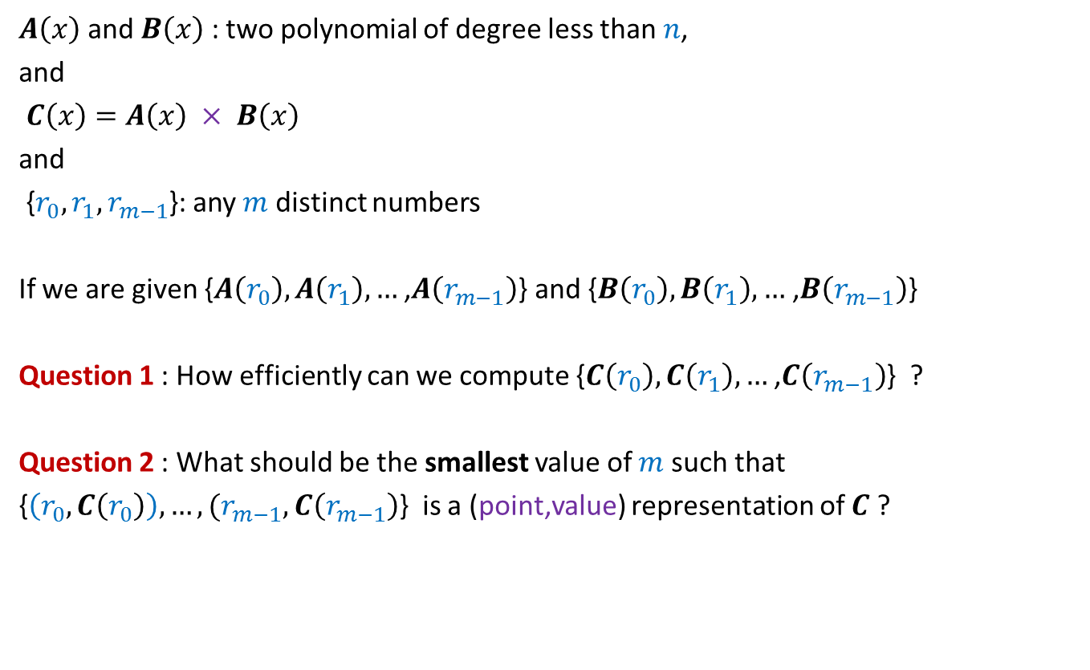

Questions
$A\left(x\right)$ and $B\left(x\right)$: two polynomial of degree less than $n$,
and
$C\left(x\right)=A\left(x\right) × B\left(x\right)$
and
{$r_{0},r_{1}, r_{m−1}$}: any $m$ distinct numbers
If we are given {$A\left(r_{0}\right),A\left(r_{1}\right),…$ ,$A\left(r_{m−1}\right)$} and {$B\left(r_{0}\right),B\left(r_{1}\right),…$ ,$B\left(r_{m−1}\right)$}
Question 1 : How efficiently can we compute {$C\left(r_{0}\right),C\left(r_{1}\right),…$ ,$C\left(r_{m−1}\right)$} ?
Question 2 : What should be the smallest value of $m$ such that
{$\left(r_{0}, C\left(r_{0}\right)\right),…,(r_{m−1}, C\left(r_{m−1}\right)$} is a (point,value) representation of $C$ ?
O($m$) time
$$2n−1$$

Slide 16
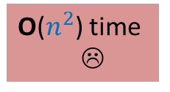

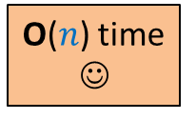
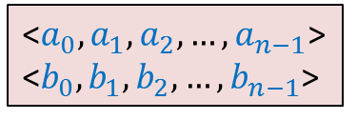
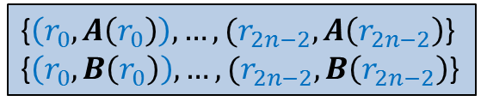
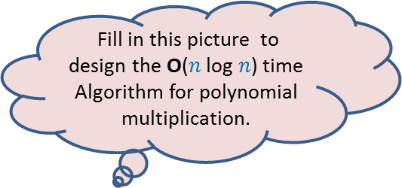


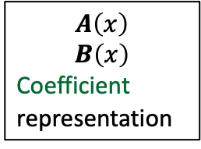

O($n^{2}$) time
☹
$$A\left(x\right)$$
$$B\left(x\right)$$
Coefficient
representation
<$a_{0}, a_{1},a_{2},…,a_{n−1}$>
<$b_{0}, b_{1},b_{2},…,b_{n−1}$>
<$c_{0}, c_{1},c_{2},…,c_{2n−2}$>
Fill in this picture to design the O($n$ log $n$) time
Algorithm for polynomial multiplication.
O($n$ log $n$) time
O($n$ log $n$) time
{$\left(r_{0}, A\left(r_{0}\right)\right),…,(r_{2n−2}, A\left(r_{2n−2}\right)$}
{$\left(r_{0}, B\left(r_{0}\right)\right),…,(r_{2n−2}, B\left(r_{2n−2}\right)$}
{$\left(r_{0}, C\left(r_{0}\right)\right),…,(r_{2n−2}, C\left(r_{2n−2}\right)$}
O($n$) time
☺

Slide 17

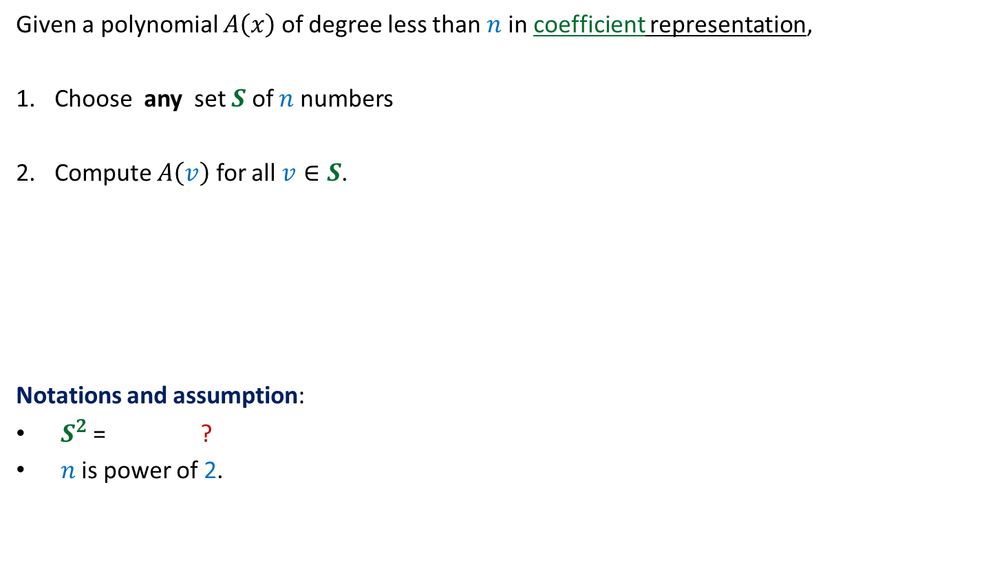
Sub-problem 1
Given a polynomial $A\left(x\right)$ of degree less than $n$in coefficient representation,
Choose any set $S$ of $n$ numbers
Compute $A\left(v\right)$ for all $v∈S$.
Notations and assumption:
$S^{2}$ = ?
$n$ is power of 2.
{$v^{2}$ | $v∈S$ }

Slide 18

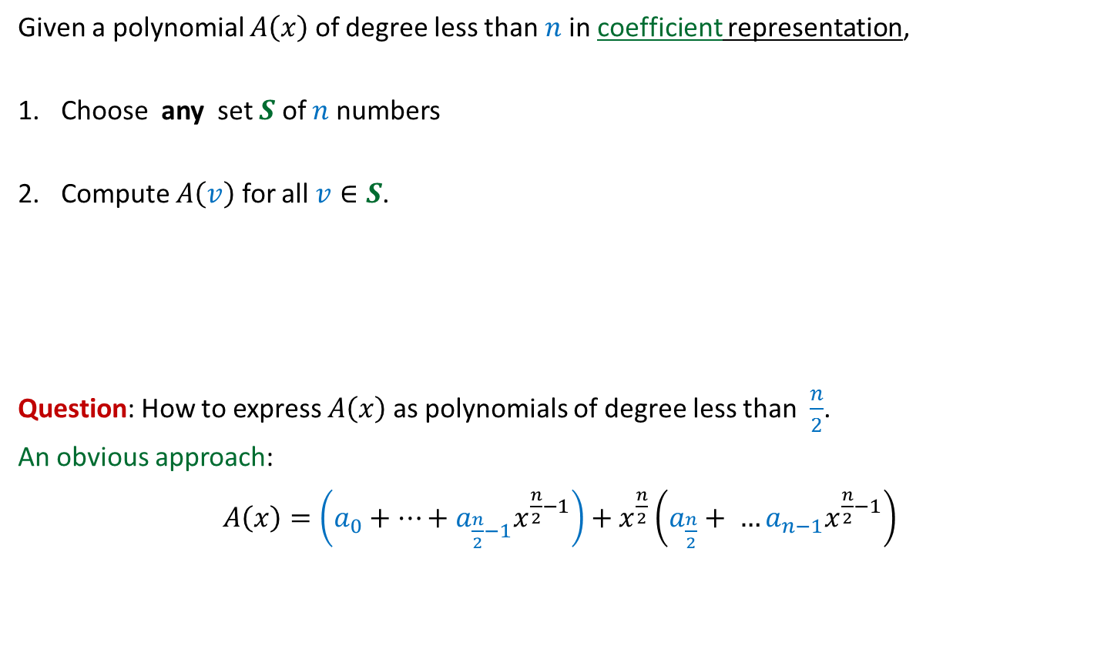
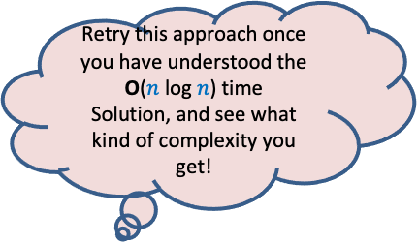
Sub-problem 1
Given a polynomial $A\left(x\right)$ of degree less than $n$in coefficient representation,
Choose any set $S$ of $n$ numbers
Compute $A\left(v\right)$ for all $v∈S$.
Question: How to express $A\left(x\right)$ as polynomials of degree less than $\frac{n}{2}$.
An obvious approach:
$A\left(x\right)=\left(a_{0}+…+a_{\frac{n}{2}−1}x^{\frac{n}{2}−1}\right)+x^{\frac{n}{2}}\left(a_{\frac{n}{2}}+ …a_{n−1}x^{\frac{n}{2}−1}\right)$
Think for a moment for any set $S$ you like and freeze it.
Retry this approach once you have understood the O($n$ log $n$) time
Solution, and see what kind of complexity you get!
$$A\left(x\right)=a_{0}+a_{1}x+a_{2}x^{2}+ …a_{n−1}x^{n−1}$$

Slide 19








Divide and Conquer approach
$A\left(x\right)=a_{0}+a_{1}x+a_{2}x^{2}+a_{3}x^{3}+…+a_{n−2}x^{n−2}+a_{n−1}x^{n−1}$
= ? $+$ ?
Question:
If $A_{even}(x)$= $a_{0}+a_{2}x+ …+a_{n−2}x^{\frac{n}{2}−1}$
and $A_{odd}(x)$ = $a_{1}+a_{3}x+ …+a_{n−1}x^{\frac{n}{2}−1}$,
then what is the relation between $A$, $A_{even}$, and $A_{odd}$ ?
Answer: ?
➔Evaluating $A\left(x\right)$ on $S$ $≡$ ? + ? +
$$\left(a_{0}+a_{2}x^{2}+…+a_{n−2}x^{n−2}\right)$$
$x(a_{1}+a_{3}x^{2}+…+a_{n−1}x^{n−2}$)
$A_{even}$($x^{2}$)
?
$A_{odd}$($x^{2}$)
?
$A\left(x\right)=$ $A_{even}$($x^{2}$) + $x A_{odd}$($x^{2}$)
Evaluating $A_{even}\left(x\right)$ at $S^{2}$
Evaluating $A_{odd}\left(x\right)$ at $S^{2}$
O($n$) work
Think for a few minutes about the details of the Divide and Conquer algorithm based on this equality.

Slide 20








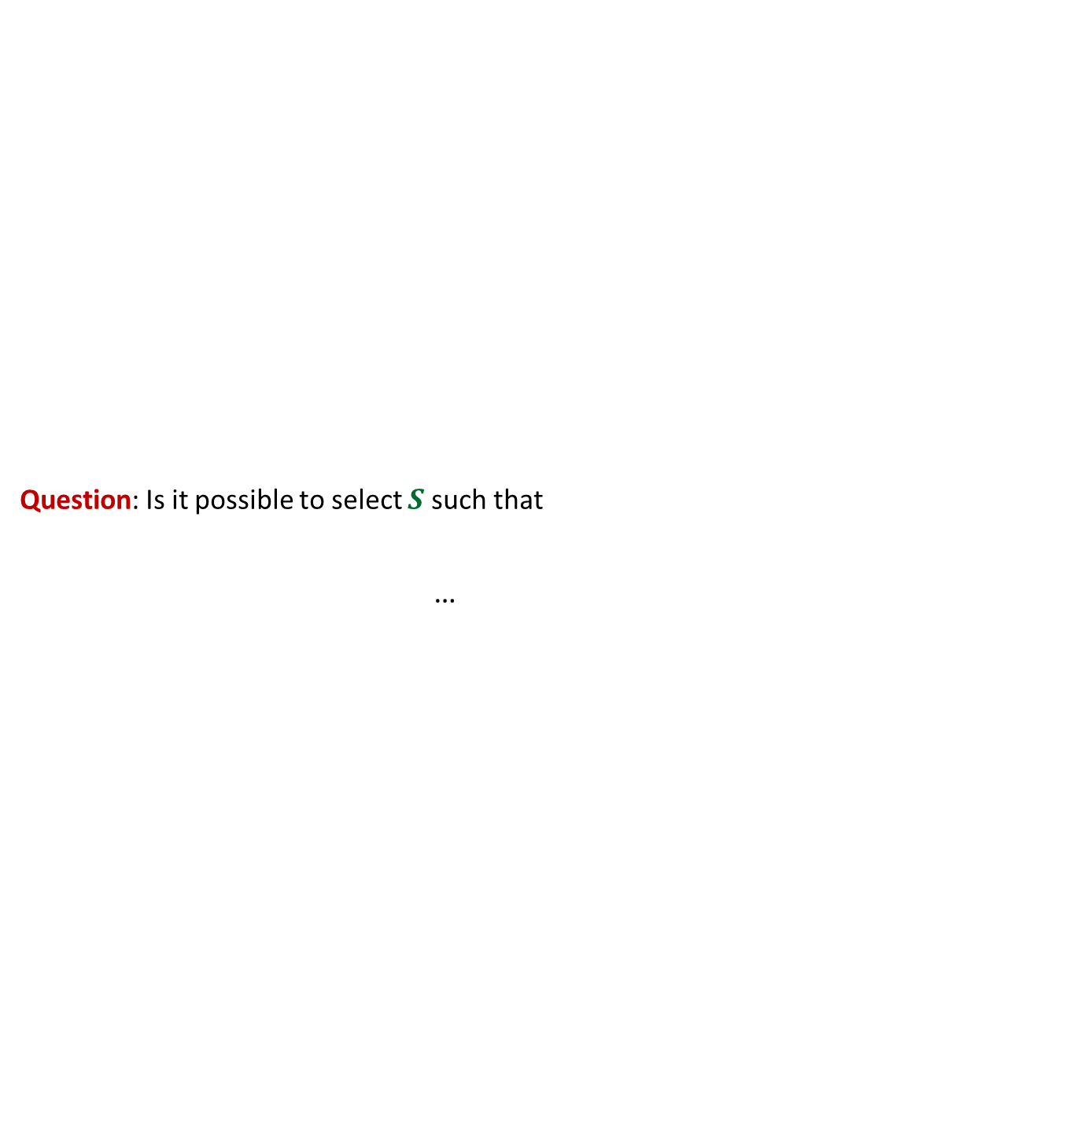













Solving the sub-problem
points
for
evaluation
$A\left(x\right)=$ $A_{even}$($x^{2}$) + $x A_{odd}$($x^{2}$)
degree
$$A$$
$$<n$$
$$S$$
$$n$$
Question: Is it possible to select $S$ such that
…
$$A_{even}$$
$$A_{odd}$$
$$<n/2$$
$$S^{2}$$
$$n$$
$$<n/4$$
$$S^{4}$$
$$n$$
$$<1$$
$$S^{n}$$
$$n$$
$n$ polynomials, each to be evaluated at $n$ distinct numbers
$Θ\left(n^{2}\right)time$☹
This hurdle is pointing to a very important question whose answer will solve this problem …
Now recall the set $S$
you selected. What is the size of $S^{2}$, $S^{4}$, …, $S^{n}$ ?
$${|S}^{2}|=\frac{n}{2}$$
$${|S}^{4}|=\frac{n}{4}$$
$${|S}^{n}|=1$$

Slide 21
Complex numbers
Recalling elementary facts
Here we will see the power of complex numbers!

Slide 22


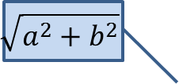
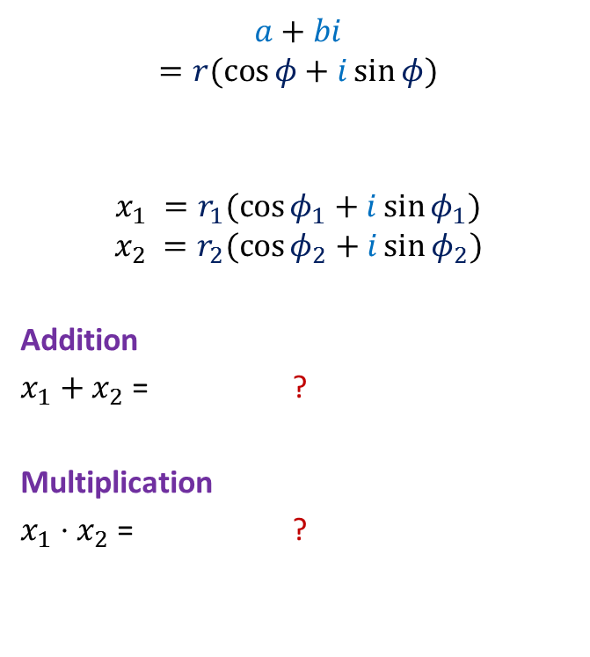

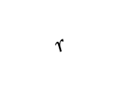

Complex numbers
$$\sqrt{a^{2}+b^{2}}$$
$$a+bi$$
$$=r(\cos{φ}+i\sin{φ})$$
$$x_{1} =r_{1}(\cos{φ_{1}}+i\sin{φ_{1}})$$
$$x_{2} =r_{2}(\cos{φ_{2}}+i\sin{φ_{2}})$$
Addition
$x_{1}+x_{2}$ = ?
Multiplication
$x_{1}⋅x_{2}$ = ?
Complex plane
$$b$$
$$r$$
$$φ$$
$$a$$
Vector addition
$$r_{1}r_{2}(\cos{(φ_{1}+φ_{2})}+i\sin{(φ_{1}+φ_{2})})$$
Magnitudes get multiplied &
Arguments get added… beautiful ☺

Slide 23

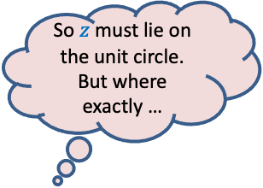
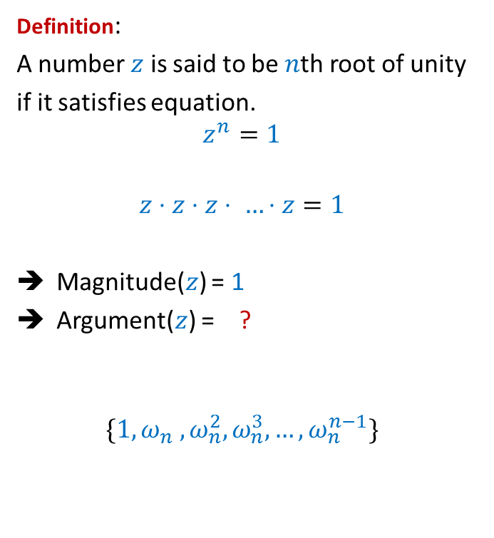
Complex roots of unity
Definition:
A number $z$ is said to be $n$th root of unity
if it satisfies equation.
$$z^{n}=1$$
$$z⋅z⋅z⋅ …⋅z=1$$
Magnitude($z$) = 1
Argument($z$) = ?
$$\{1, ω_{n} ,ω_{n}^{2},ω_{n}^{3},…,ω_{n}^{n−1}\}$$
Complex plane
$$\frac{2π}{n}$$
$$1$$
multiple of $\frac{2π}{n}$
So $z$ must lie on the unit circle. But where exactly …
$$R_{n}=$$
Unit circle

Slide 24

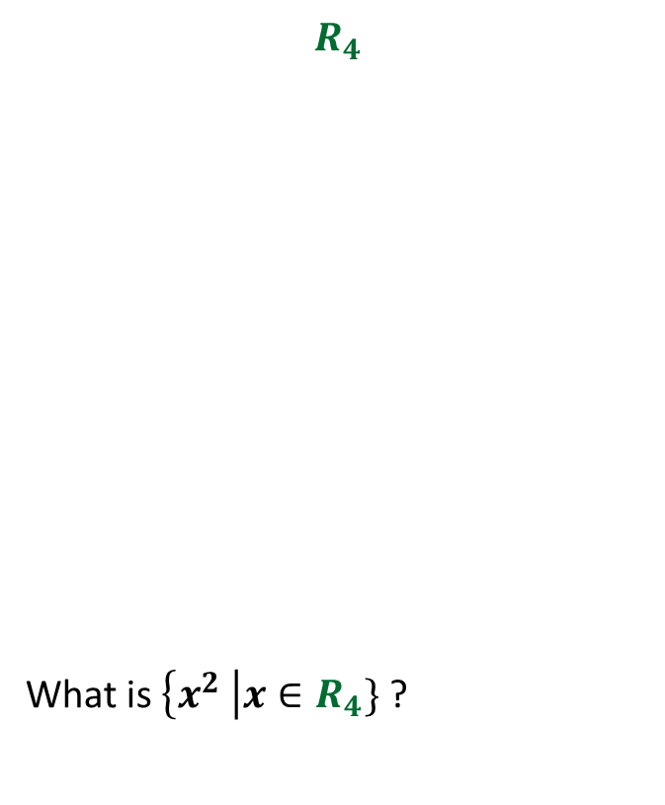









Complex roots of unity
$$R_{3}$$
What is $\left\{x^{2} \right|x∈R_{3}\}$ ?
$$R_{4}$$
What is $\left\{x^{2} \right|x∈R_{4}\}$ ?
$$ω_{4}^{1}$$
$$ω_{3}^{1}$$
$$ω_{3}^{3}$$
$$ω_{4}^{2}$$
$$ω_{4}^{4}$$
$$ω_{3}^{2}$$
$$ω_{4}^{3}$$
$$R_{3}$$
$$R_{2}$$

Slide 25
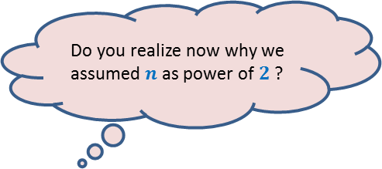




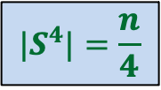
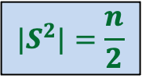
Complex roots of unity
Theorem:
If $n$ is odd $R_{n}2=R_{n}$
If $n$ is even $R_{n}2=$ $R_{\frac{n}{2}}$
Is it possible to select $S$ such that
…
?
$${|S}^{2}|=\frac{n}{2}$$
$${|S}^{4}|=\frac{n}{4}$$
$${|S}^{n}|=1$$
Yes! Choose
$$S=R_{n}$$
Do you realize now why we assumed $n$ as power of $2$ ?

Slide 26


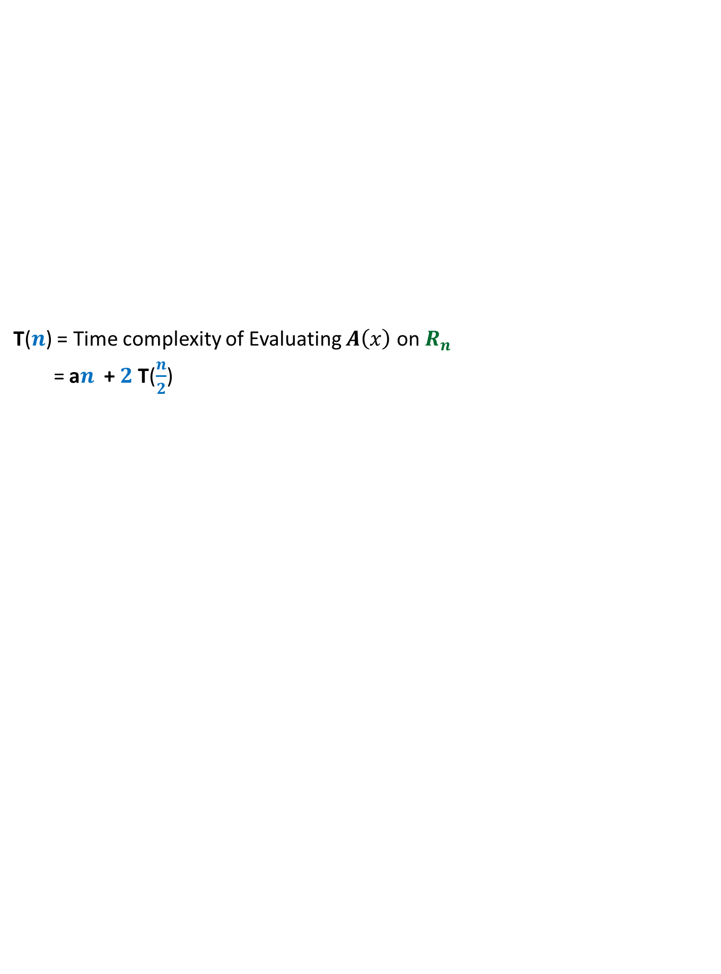


Solving the sub-problem
points
for
evaluation
$A\left(x\right)=$ $A_{even}$($x^{2}$) + $x A_{odd}$($x^{2}$)
degree
$$A$$
$$<n$$
$$R_{n}$$
T($n$) = Time complexity of Evaluating $A\left(x\right)$ on $R_{n}$
= a$n$ + $2$T($\frac{n}{2}$)
$$A_{even}$$
$$A_{odd}$$
$$<n/2$$
$$R_{\frac{n}{2}}$$
$$<n/4$$
$$R_{\frac{n}{4}}$$
$$<1$$
$$R_{1}$$

Slide 27
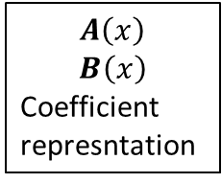
O($n^{2}$) time
☹
$$A\left(x\right)$$
$$B\left(x\right)$$
Coefficient
represntation
<$a_{0}, a_{1},a_{2},…,a_{n−1}$>
<$b_{0}, b_{1},b_{2},…,b_{n−1}$>
<$c_{0}, c_{1},c_{2},…,c_{2n−2}$>
O($n$ log $n$) time
Done
?
O($n$ log $n$) time
{$\left(r_{0}, A\left(r_{0}\right)\right),…,(r_{2n−2}, A\left(r_{2n−2}\right)$}
{$\left(r_{0}, B\left(r_{0}\right)\right),…,(r_{2n−2}, B\left(r_{2n−2}\right)$}
{$\left(r_{0}, C\left(r_{0}\right)\right),…,(r_{2n−2}, C\left(r_{2n−2}\right)$}
O($n$) time
☺

Slide 28


Sub-problem 2
Given a polynomial $C\left(x\right)$ of degree less than $n$in (point,value) representation,
Compute its coefficient representation.
Given $\left\{d_{0},d_{1},…,d_{n−1}\right\}$ where
$d_{j}=C\left(ω_{n}^{j}\right)$
How to infer $c_{i}$ ?
Homework: Establish a relation between $D\left(ω_{n}^{k}\right)$ and $c_{n−k}$ ?
Do this homework sincerely if you wish to internalize the entire solution of the problem …
$$C\left(x\right)=c_{0}+c_{1}x+c_{2}x^{2}+ …c_{n−1}x^{n−1}$$
What should be that polynomial.
…Think simple ☺
Hint: This problem can also be viewed as an instance of Sub-problem 1.
$$D\left(x\right)=d_{0}+d_{1}x+d_{2}x^{2}+ …d_{n−1}x^{n−1}$$

Slide 29
To test your coding skills
Homework:
The algorithm involves complex roots of unity. But these numbers are
imaginary (not supported in programming language☹.)
So how to write the code of the algorithm in C ?

